Slide 1
Union-Find
Algorithm : Design & Analysis
[10]

Slide 2
In the last class…
Hashing
Collision Handling for Hashing
  Closed Address Hashing
  Open Address Hashing
Hash Functions
Array Doubling and Amortized Analysis

Slide 3
Union-Find
Dynamic Equivalence Relation
Implementing Dynamic Set by Union-Find
  Straight Union-Find
  Making Shorter Tree by Weighted Union
  Compressing Path by Compressing-Find
Amortized Analysis of wUnion-cFind

Slide 4
Maze Creating: an Example
Selecting a wall to pull down randomly
Inlet
i
If i,j are in same equivalence class, then select another wall to pull down, otherwise, joint the two classes into one.
The maze is complete when the inlet and outlet are in one equivalence class.
j
Outlet

Slide 5
A More Serious Example
Kruskal’s algorithm for MST(the minimum spaning tree).
Greedy strategy: Select the edge not in the tree with the minimum weight, which will NOT result in a cycle with the edges having been selected.
How to know NO CYCLE, however?

Slide 6
Dynamic Equivalence Relations
Equivalence
  reflexive, symmetric, transitive
  equivalent classes forming a partition
Dynamic equivalence relation
  changing in the process of computation
  IS instruction: yes or no (in the same equivalence class)
  MAKE instruction: combining two equivalent classes, by relating two unrelated elements, and influencing the results of subsequent IS instructions.
  Starting as equality relation

Slide 7

Implementation: How to Measure
The number of basic operations for processing a sequence of m MAKE and/or IS instructions on a set S with n elements.
An Example: S={1,2,3,4,5}
  0. [create] {{1}, {2}, {3}, {4}, {5}}
  1. IS 2≡4? No
  2. IS 3≡5? No
  3. MAKE 3≡5. {{1}, {2}, {3,5}, {4}}
  4. MAKE 2≡5. {{1}, {2,3,5}, {4}}
  5. IS 2≡3? Yes
  6. MAKE 4≡1. {{1,4}, {2,3,5}}
  7. IS 2≡4? No

Slide 8
Implementation: Choices
Matrix (relation matrix)
  Space in Θ(n²), and worst-case cost in Θ(mn) (mainly for row copying for MAKE).
Array (for equivalence class id.)
  Space in Θ(n), and worst-case cost in Θ(mn) (mainly for search and change for MAKE).
Union-Find
  A object of type Union-Find is a collection of disjoint sets
  There is no way to traverse through all the elements in one set.

Slide 9
Union-Find ADT
Constructor: Union-Find create(int n)
  sets=create(n) refers to a newly created group of sets {1}, {2}, ..., {n} (n singletons)
Access Function: int find(UnionFind sets, e)
  find(sets, e)=<e>
Manipulation Procedures
  void makeSet(UnionFind sets, int e)
  void union(UnionFind sets, int s, int t)

Slide 10
Implementing Dynamic Equivalence
Using Union-Find (as inTree)
implementation by inTree
IS s_{i} ≡ s_{j} :
  t=find(s_{i});
  u=find(s_{j});
  (t==u)?
MAKE s_{i} ≡ s_{j} :
  t=find(s_{i});
  u=find(s_{j});
  union(t,u);
create(n): sequence of makeNode
0
1
i
n-1
n
u
union(t,u)
u
find(s_{j})=u
t
setParent(t,u)
parent^{k}(s_{j})
s_{j}

Slide 11
Union-Find Program
A union-find program of length m is (a create(n) operation followed by) a sequence of m union and/or find operations interspersed in any order.
A union-find program is considered an input, the object for which the analysis is conducted.
The measure: number of accesses to the parent
  assignments: for union operations
  lookups: for find operations
link operation

Slide 12
Worst-case Analysis for Union-Find Program
Assuming each lookup/assignment take Ο(1).
Each makeSet or union does one assignment, and each find does d+1 lookups, where d is the depth of the node.
Union(1,2)
Union(2,3)
n-1. Union(n-1,n)
Find(1)
Find(1)
Example
The sequence of Union makes a chain of length n-1, which is the tree with the largest height
operations done:
n+(n-1)+(m-n+1)n
Θ (mn)
Find(1) needs n array lookups

Slide 13
Weighted Union: for Short Trees
Weighted union: always have the tree with fewer nodes as subtree. (wUnion)
To keep the Union valid, each Union operation is replaced by:
t=find(i);
u=find(j);
union(t,u)
2
Not the worst case!
n
1
3
n-1
Tree made by wUnion
The order of (t,u) satisfying the requirement
Cost for the program:
n+3(n-1)+2(m-n+1)

Slide 14

Upper Bound of Tree Height
After any sequence of Union instructions, implemented by wUnion, any tree that has k nodes will have height at most ⎣lgk⎦
Proof by induction on k:
  base case: k=1, the height is 0.
  by inductive hypothesis:
    h₁≤ ⎣lgk₁⎦, h₂≤ ⎣lgk₂⎦
  h=max(h1, h2+1), k=k1+k2
    if h=h₁, h≤ ⎣lgk₁⎦≤ ⎣lgk⎦
    if h=h₂+1, note: k₂≤k/2
    so, h₂+1≤ ⎣lgk₂⎦+1≤ ⎣lgk⎦
t
u
T₁
k₁ nodes
height h₁
T₂
k₂ nodes
height h₂
T
k nodes
height h

Slide 15
Upper Bound for Union-Find Program
A Union-Find program of size m, on a set of n elements, performs Θ(n+mlogn) link operations in the worst case if wUnion and straight find are used.
Proof:
  At most n-1 wUnion can be done, building a tree with height at most ⎣lgn⎦,
  Then, each find costs at most ⎣lgn⎦+1.
  Each wUnion costs in Ο(1), so, the upper bound on the cost of any combination of m wUnion/find operations is the cost of m find operations, that is m(⎣lgn⎦+1)∈ Ο (n+mlogn)
  There do exist programs requiring Ω(n+mlogn) steps.

Slide 16
Path Compression
Path compressed
x
w
v
v
w
x
Change their parents to the root

Slide 17
Challenges for the Analysis
Path compressed
x
w
v
v
w
x
cFind does twice as many link operations as the find does for a given node in a given tree.
cFind will traverse shorter paths
But…

Slide 18
Analysis: the Basic Idea
cFind may be an expensive operation, in the case that find(i) is executed and the node i has great depth.
However, such cFind can be executed only for limited times, relative to other operations of lower cost.
So, amortized analysis applys.

Slide 19
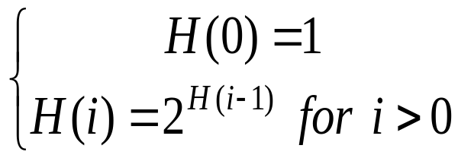
Co-Strength of wUnion and cFind
The number of link operations done by a Union-Find program implemented with wUnion and cFind, of length m on a set of n elements is in O((n+m)lg*(n)) in the worst case.
What’s lg*(n)?
  Define the function H as following:
  Then, lg*(j) for j≥1 is defined as:
  lg*(j)=min{ k|H(k)≥j }

Slide 20
Definitions with a Union-Find Program P
Forest F: the forest constructed by the sequence of union instructions in P, assuming:
  wUnion is used;
  the finds in the P are ignored
Height of a node v in any tree: the height of the subtree rooted at v
Rank of v: the height of v in F
Note: cFind changes the height of a node, but the rank for any node is invariable.

Slide 21
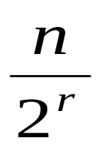
Constraints on Ranks in F
The upper bound of the number of nodes with rank r (r≥0) is
  Remember that the height of the tree built by wUnion is at most ⎣lgn⎦, which means the subtree of height r has at least 2^{r} nodes.
  The subtrees with root at rank r are disjoint.
There are at most ⎣lgn⎦ different ranks.
  There are altogether n elements in S, that is, n nodes in F.

Slide 22
Increasing Sequence of Ranks
The ranks of the nodes on a path from a leaf to a root of a tree in F form a strictly increasing sequence.
When a cFind operation changes the parent of a node, the new parent has higher rank than the old parent of that node.
  Note: the new parent was an ancestor of the previous parent.

Slide 23
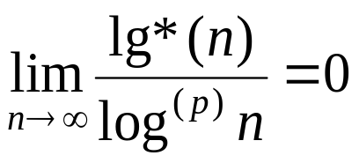
A Function Growing Extremely Slowly
Function Log-star
  lg*(j) is defined as the least i such that:
  H(i)≥j for j>0
Log-star grows extremely slowly
p is any fixed nonnegative constant
Function H:
  H(0)=1
  H(i+1)=2^{H (i)}
  that is: H(k)=2
  Note:
  H grows extremely fast:
  H(4)=2¹⁶=65536
  H(5)=2⁶⁵⁵³⁶
2
2
2
k 2’s
For any x: 2¹⁶≤x≤2⁶⁵⁵³⁶-1, lg*(x)=5 !

Slide 24
Grouping Nodes by Ranks
Node v∈s_{i} (i≥0) iff. lg*(1+rank of v)=i
  which means that: if node v is in group i, then
  r_{v} ≤ H(i)-1, but not in group with smaller labels
So,
  Group 0: all nodes with rank 0
  Group 1: all nodes with rank 1
  Group 2: all nodes with rank 2 or 3
  Group 3: all nodes with its rank in [4,15]
  Group 4: all nodes with its rank in [16, 65535]
  Group 5: all nodes with its rank in [65536, ???]
Group 5 exists only when n is at least 2⁶⁵⁵³⁶. What is that?

Slide 25
Very Few Groups
Node v∈S_{i} (i≥0) iff.
lg*(1+rank of v)=i
Upper bound of the number of distinct node groups is lg*(n+1)
  The rank of any node in F is at most ⎣lgn⎦, so the largest group index is lg*(1+ ⎣lgn⎦)=lg*(⎡lgn+1⎤) = lg*(n+1)-1
If lg*(n+1)=k, then
k 2’s
2
2
Log.
2
2
≥n+1
(k-1) 2’s
2
2
2
≥lg(n+1)

Slide 26
Amortized Cost of Union-Find
Amortized Equation Recalled
The operations to be considered:
  n makeSets
  m w-union & c-find (with at most n-1 unions)
amortized cost = actual cost + accounting cost

Slide 27
One Execution of cFind(w₀)
Root=w_{k}
Only when k=0,1, there is no parent change
Groups in a strict increasing order
w_{k-1}
For one cFind operation, the actual cost is 2k Not 2(k+1)
Group Boundary
w_{i}
Accounting cost is -2 for each pair of (w_{i-1}, w_{i}) for the the 2 nodes in ths same group only, which we call a withdrawal.
w_{i-1}
Note: the ranks are not consecutive generally
v=w₀

Slide 28
Amortizing Scheme for wUnion-cFind
makeSet
  Accounting cost is 4lg*(n+1)
  So, the amortized cost is 1+4lg*(n+1)
wUnion
  Accounting cost is 0
  So the amortized cost is 1
cFind
  Accounting cost is describes as in the previous page.
  Amortized cost ≤ 2k-2((k-1)-(lg*(n+1)-1))=2lg*(n+1) (Compare with the worst case cost of cFind, 2lgn)
Number of withdrawal

Slide 29
Validation of the Amortizing Scheme
We must be assure that the sum of the accounting costs is never negative.
The sum of the negative charges, incurred by cFind, does not exceed 4nlg*(n+1)
  We prove this by showing that at most 2nlg*(n+1) withdrawals on nodes occur during all the executions of cFind.

Slide 30
Key Idea in the Derivation
For any node, the number of withdrawal will be less than the number of different ranks in the group it belongs to
  When a cFind changes the parent of a node, the new parent is always has higher rank than the old parent.
  Once a node is assigned a new parent in a higher group, no more negative amortized cost will incurred for it again.
The number of different ranks is limited within a group.

Slide 31
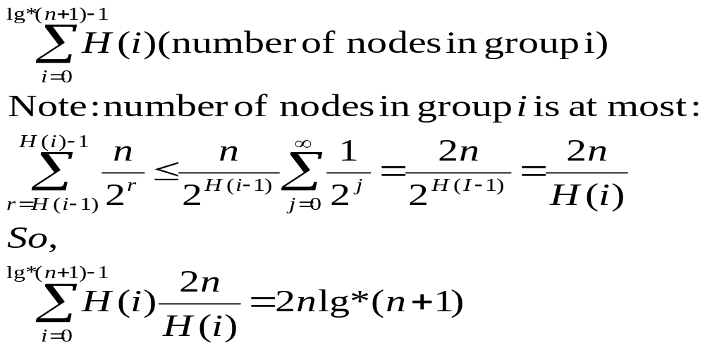
Derivation
a loose upper bound of ranks in a group
The number of withdrawals for all w∈S is:

Slide 32
The Conclusion
The number of link operations done by a Union-Find program implemented with wUnion and cFind, of length m on a set of n elements is in O((n+m)lg*(n)) in the worst case.
  Note: since the sum of accounting cost is never negative, the actual cost is always not less than amortized cost. And, the upper bound of amortized cost is: (n+m)(1+4lg*(n+1))

Slide 33
Home Assignments
6.19
6.21
6.23
6.25-27

